Slide 1

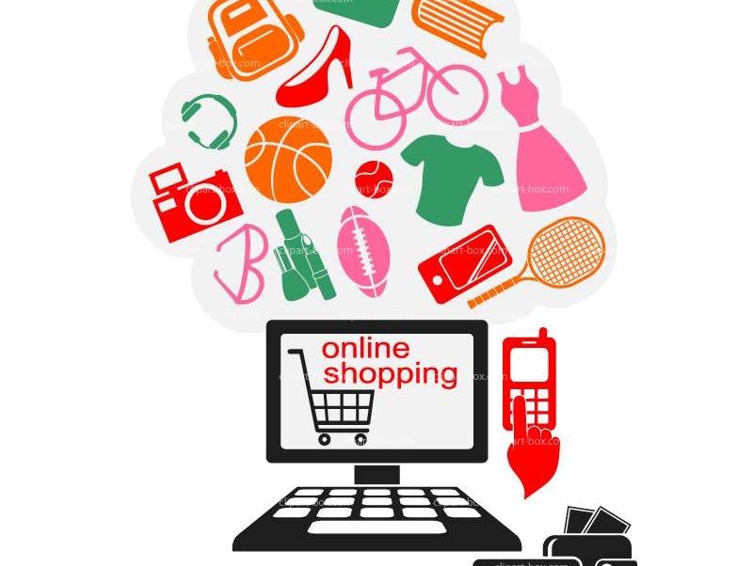
Shopping Behavior Analysis of Instacart Customers and RecommendingTailored Products
-Oindrila Sen

Slide 2
Why Online Shopping?
It’s open 24*7
No more worry for parking or getting dressed
Thousands of options to explore
- No more standing at checkout queues

Slide 3
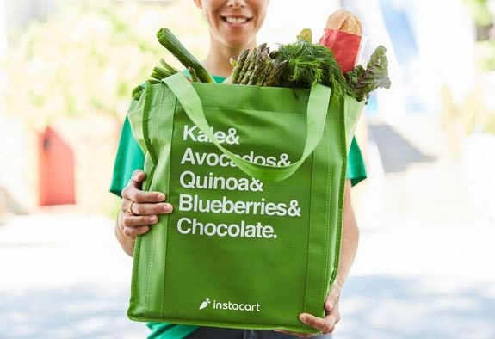
What is Instacart?
Customers place orders online from one of their grocery retail partners
A personal shopper engaged by Instacart picks the items from the store
The Shopper delivers them within an hour at the doorstep

Slide 4
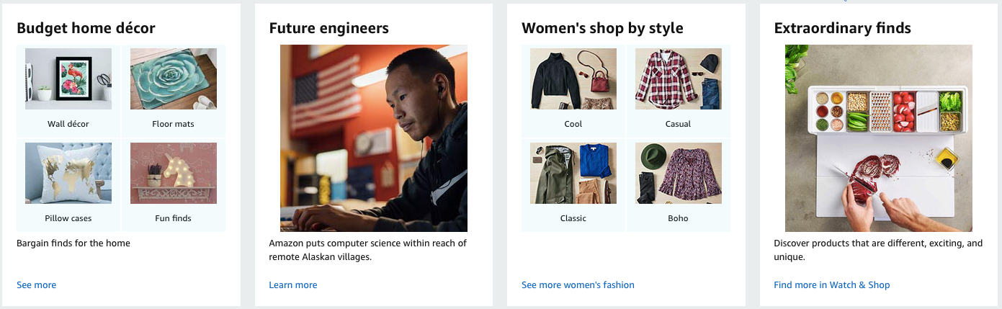
What is Product Recommendation?
Product Recommendation is basically a data filtering tool that make use of algorithms
and data to recommend the most relevant items to a particular user.
Importance:
Boost revenues and CTRs
Customer satisfaction
Customer Retention

Slide 5

Why Recommendation?
People Influence People
Thousands of Options
Suggestion or Endorsement helps to Decide
- Opens Door to New unexplored Items

Slide 6
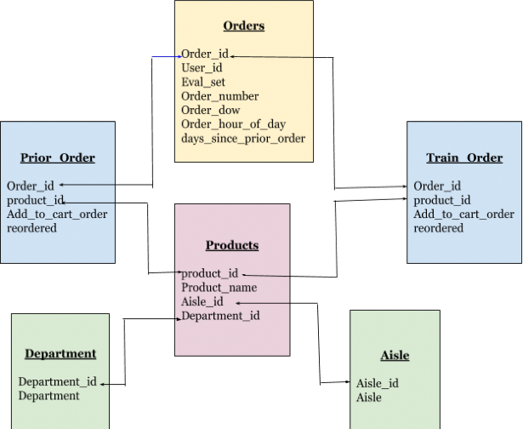
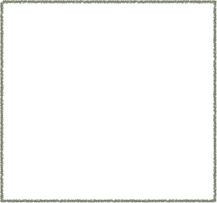
“The Instacart Online Grocery Shopping Dataset 2017”, Accessed from Intsacart on 07/10/2019.
Data Source
Data Model
Data Counts:
Aisles: 134 Departments: 21 Products: 49688 Customers: 206209 Orders: 3421083

Slide 7
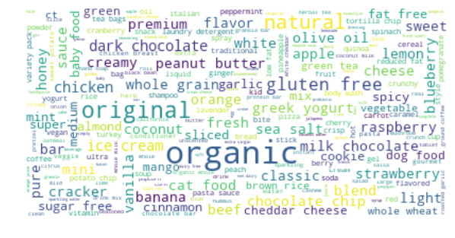
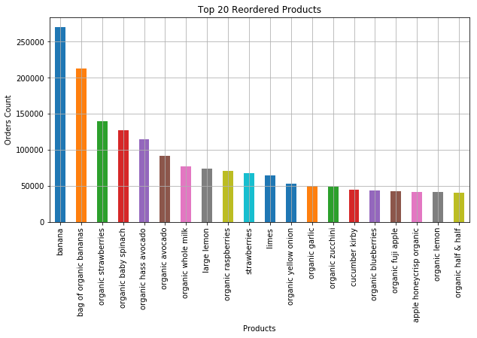
Data Visualizations
Most Popular Products

Slide 8
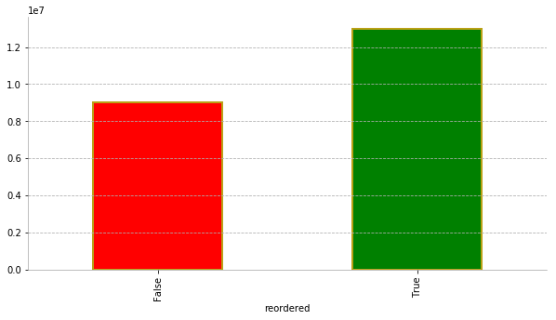
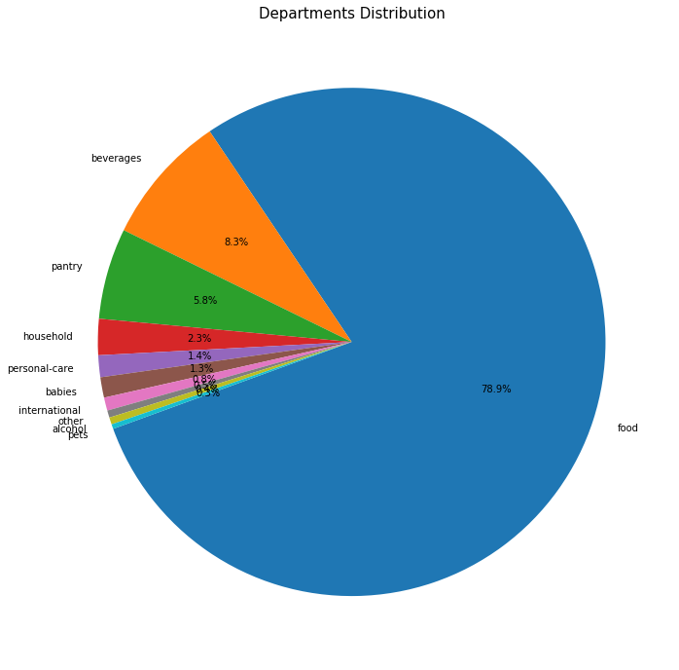
Data Visualizations
Products Re-ordered
Department-Wise Distribution

Slide 9
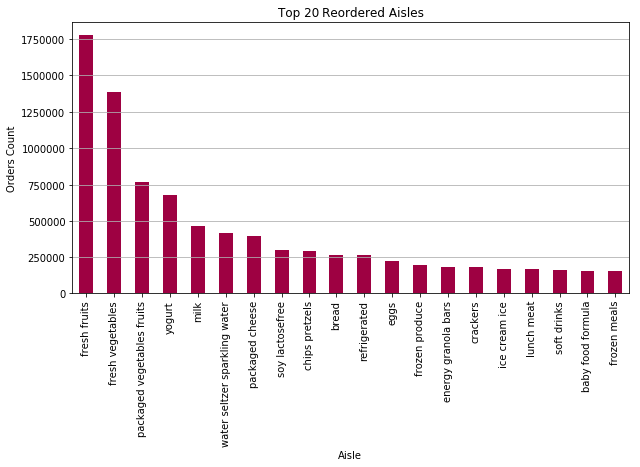
Data Visualizations
Most Reordered Aisles

Slide 10
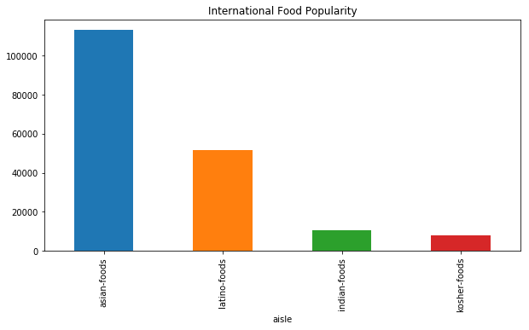
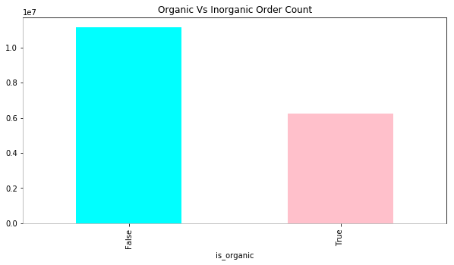
Data Visualizations
Customers Food Preference

Slide 11
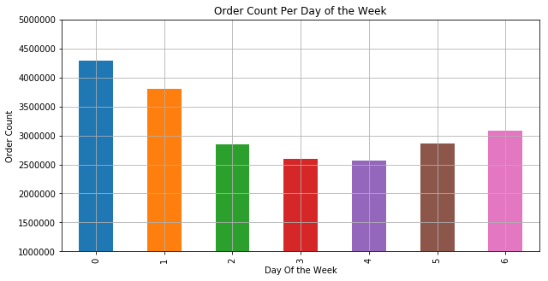
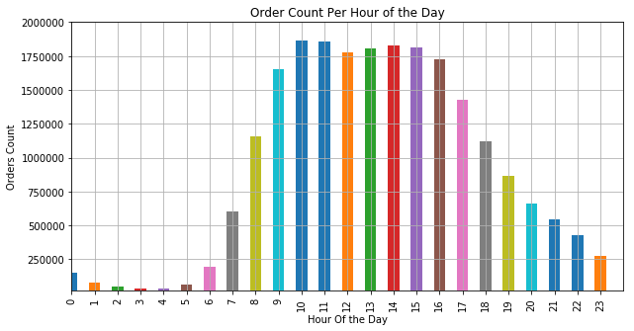
Data Visualizations
Customers Preferred Day and Time to Order

Slide 12
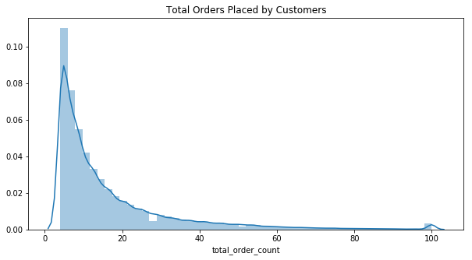
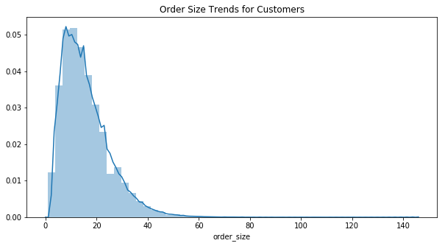
Data Visualizations
Total Orders
Per Customer
Items added
Per Order

Slide 13
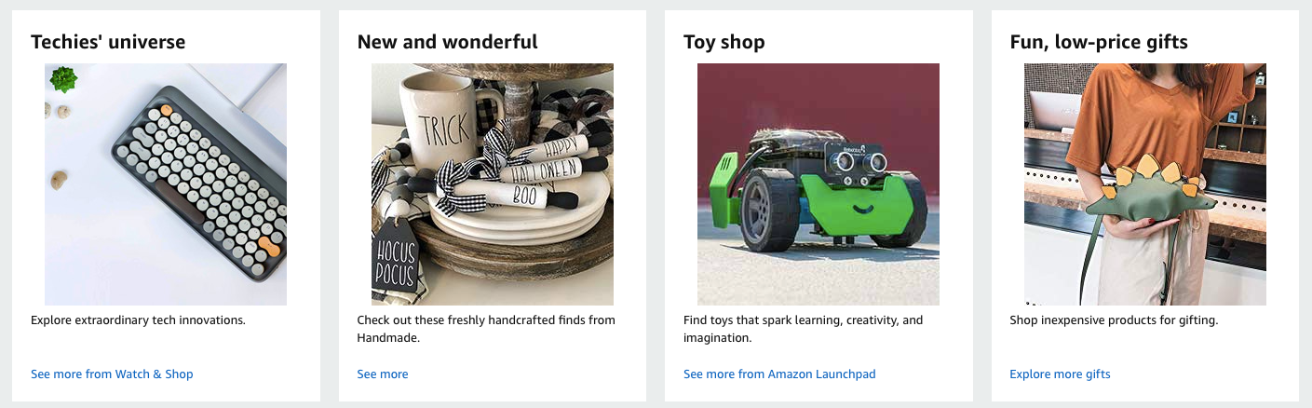
Basic Recommendations
Trending Products at Instacart
Popular Products from the Department that the Customers are interested in
Products that are reordered most
- Unexplored/Unique Products

Slide 14
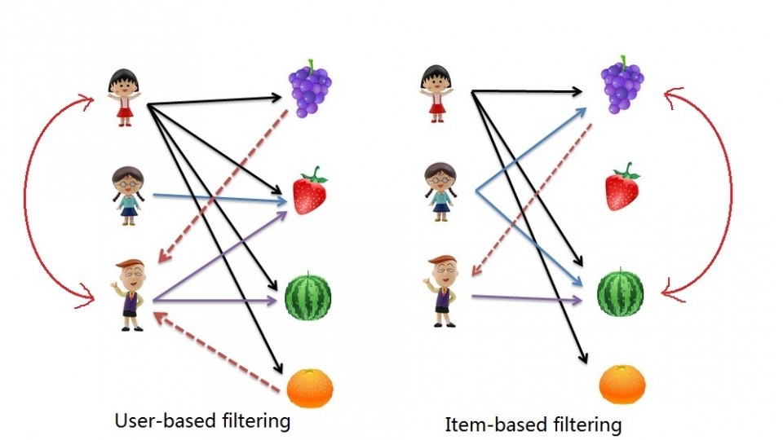
Collaborative Filtering for Implicit Data
Implicit Data:
The data gathered from users behavior but without any ratings
Users barely submit ratings
Easy to collect
Hard to Recommend
Collaborative Filtering:
Recommendations based on collecting and analyzing information on user’s behaviors, their activities or preferences and predicting what they will like based on the similarity with other users
A matrix Based Approach
In the product recommendation, it is user * item matrix
Item -to- Item Recommendations
User-to-User Recommendations
A measure of similarity between two non-zero vectors by calculating the cosine of the angle between them

Slide 15
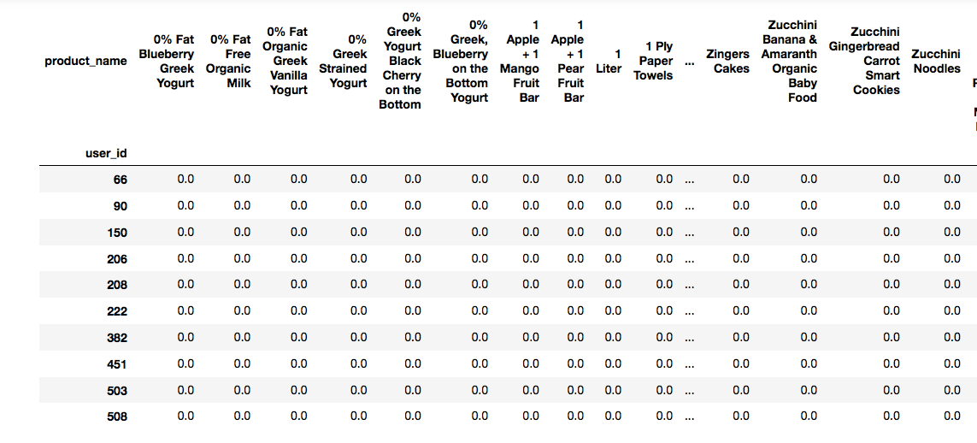
Collaborative Filtering- Contd.
User-to-User Recommendations:
Similar people have similar taste
Steps to create a user-to-user Recommendation Model
- Construct the co-occurrence matrix, users x items
- Use a metric like Cosine, Euclidian, Pearson or some other distance metric to calculate distances for each user, to all other users.

Slide 16
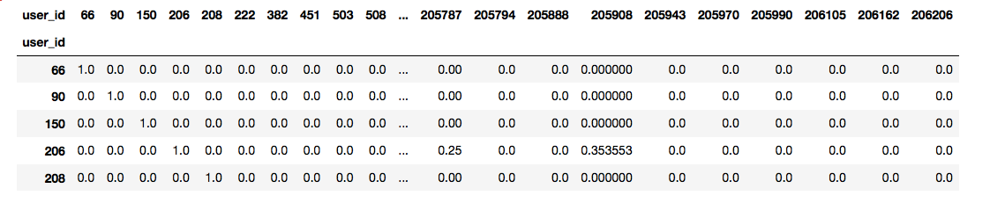
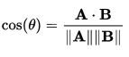
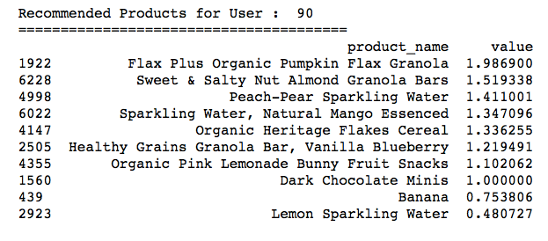
Cosine Similarity Model
Cosine similarity is a measure of similarity between two non-zero vectors of an inner product space that measures the cosine of the angle between them
Cosine of 0 degree angle is 1. Therefore, if the value is closer to 1, the more similar the users are
- The cosine of two non-zero vectors can be derived by the dot product:
- Finally, recommendation of products based on similar users

Slide 17
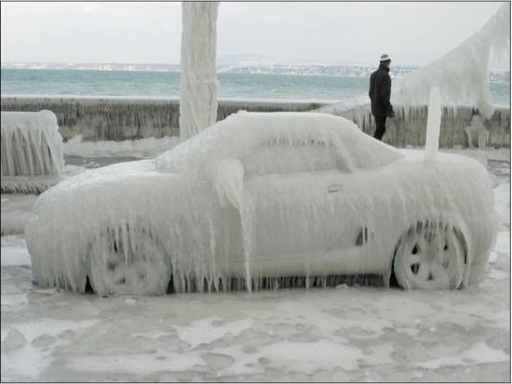
Cold-Start Problem
When a new User is registered, there is no history for the user. The system is not aware of the personal preferences of the user. Thus difficult to compare with other users or make any recommendations

Slide 18
Matrix Factorization
What is Matrix factorization?
Take a large Matrix and factor it into some smaller representation of the original matrix
Why Matrix Factorization?
To solve sparse data problem
How it works?
We have an original matrix R of size M*N where M s the number of Users and N is the Number of items
Matrix is Sparse since most of the users buy/reorder only a few items
Thus, matrix R can be factorized into two smaller matrices: one with dimension M*K as the user matrix where rows represent users and columns are latent factors(say U). The other matrix of dimension K*N is the item matrix where rows are latent factors and columns represent items(say V).
Calculate U and V so that their product approximates R as closely as possible: R ≈ U x V.

Slide 19
Alternating Least Squares (ALS)
ALS uses Matrix Factorization Method for Recommendations that runs itself in parallel fashion.
It first holds user matrix fixed and runs gradient descent with item matrix; then it holds item matrix fixed and runs gradient descent with user matrix. Thus it run alternatively minimizing two Loss Functions.
Steps To Follow:
Create two matrices, one for fitting the model (item-user) and one for recommendations(user -item) .
Initialize the Alternating Least Squares (ALS) recommendation model.
- Fit the model using the sparse item-user matrix.
- Use similar_items method to get items similar to one item and recommend method to recommend items to some user

Slide 20
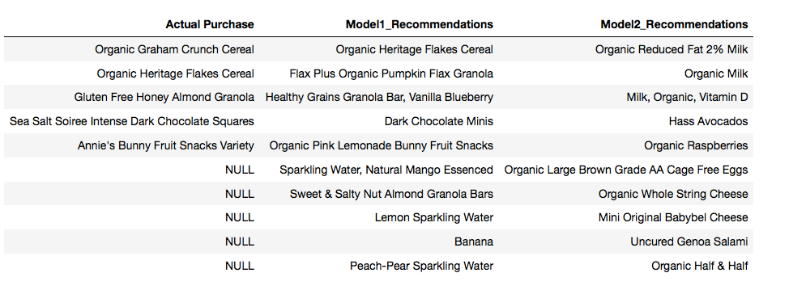
Analyze and Compare Results
Actual Purchase: Items purchased by user# 90
Model1_Recommendations: Items Recommended by Cosine Similarity Model for User# 90
Model2_Recommendations: Items Recommended by ALS Model for User# 90

Slide 21
Evaluation Metrics:
Evaluation Implicit Feedback Based Recommender system is tricky. I have followed the below steps:
Got Items purchased for all the users
Got Top 20 recommendations from each model for all the users
Calculated Recall by using Number of items actually bought which are captured in Top 20 Recommendations for each Model
Take the Average value for all users
Cosine Similarity Model Score: 0.122
ALS Model Score: 0.220

Slide 22
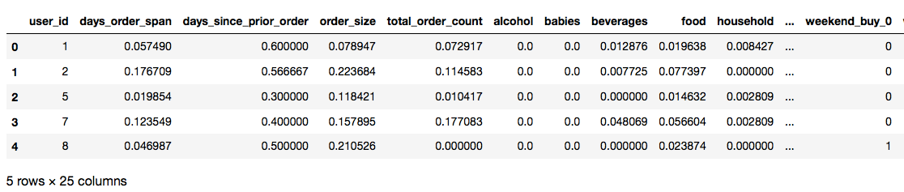
Recommendation Using Customer Classification
Approach:
Prepare data so that there is one row for each user and the Departments as Columns
Standardize the Dataset
Divide Data into Training and Test Set
Classify Customers Based on their shopping behavior into different clusters using Classification Algorithms
Recommend top10 products from each cluster

Slide 23
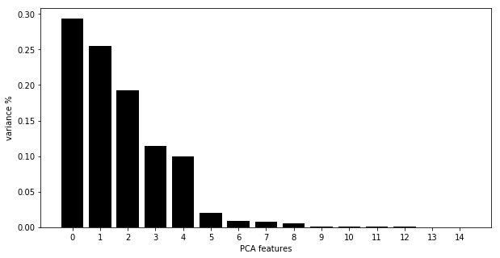
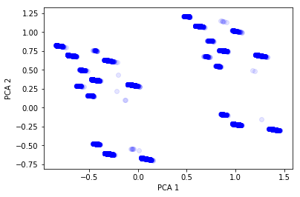
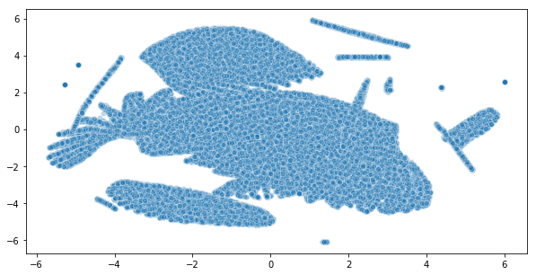
Principal Component Analysis(PCA)
t-SNE

Slide 24
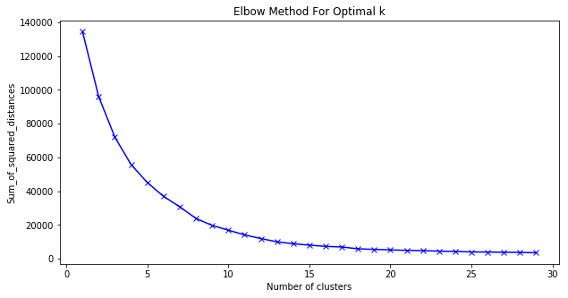
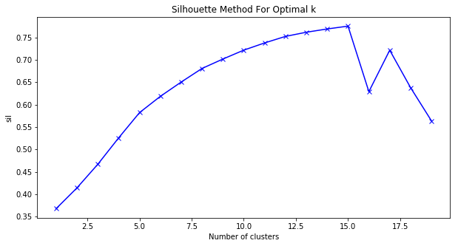
Find The Clusters
Elbow-Method
Silhoutte - Method

Slide 25
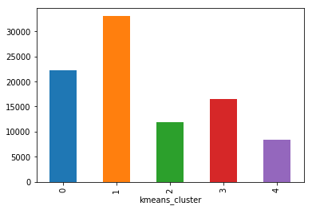
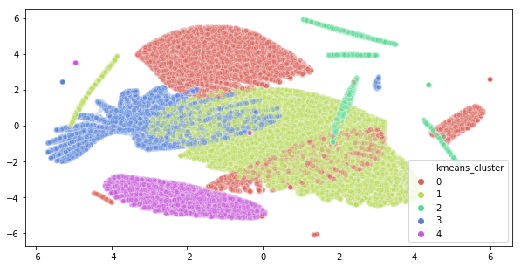
K-Means Clustering
- Define a Cluster size (say 5)
K-means algorithms identifies 5 centroids i.e.center of each cluster
Allocate each data points to the nearest cluster

Slide 26
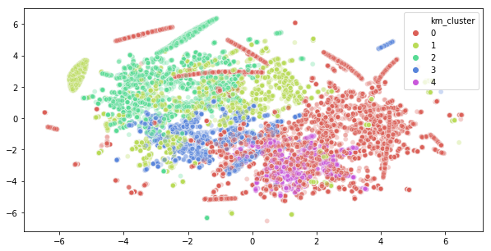
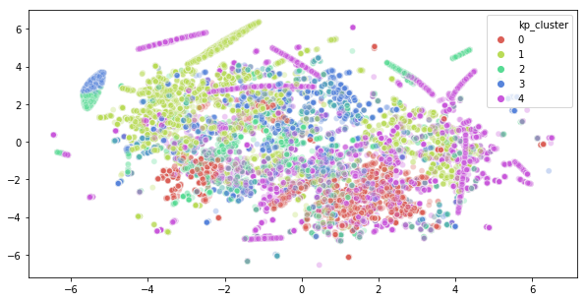
K-Mode Clustering
K-Prototype Clustering

Slide 27
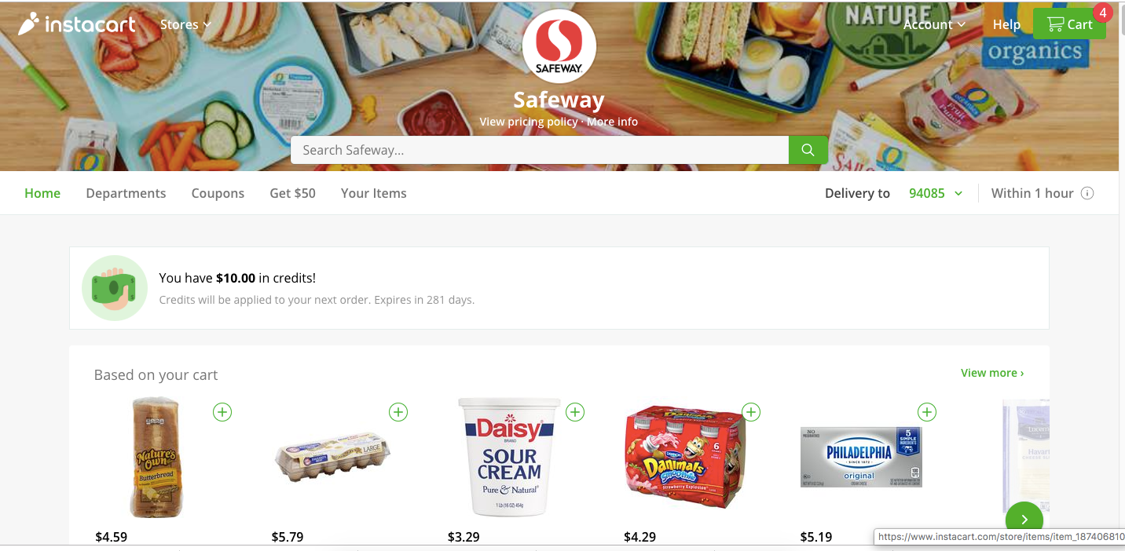
Conclusion from Customer Classification Method:
Customer order similar products at Instacart.
Top 20 products from each Cluster is Food, mainly produce items
If we exclude Food Items, then the Top20 Items from each cluster are Beverage items.
It is not appropriate to classify customers based on the products purchased
Thus Recommendation of items based on products bought by customers is not feasible with the Instacart Dataset

Slide 28
Recommend Products to Instacart Customers
The Online Shopping Portals take different approach for Recommendation based on their data model. Recommendation is tricky when there is no rating and only shopping history of the Customer.
So, I personally believe, there should be different levels of Recommendations like "trending products", "Other customers buying products", "unique unexplored products", "the products that goes well with the already purchased products" or "products other similar customers are buying".
That's what I have tried in this project - Recommending different products to Instacart Customers.
The Code of the different methods that I have explored is right here @
MyGithub

Slide 29
Thank You!

